Slide 1
Algebraic Systems

Slide 2
Need to study Algebraic systems:
Algebraic Model : Real Worlds Situation, Mathematical model, connecting mathematical model with real world situation to get real world solution.

Slide 3
Algebraic Systems or Algebras
Structure / Definition: An algebra is characterised by specifying 3 components
a set called Carrier of the Algebra
Operations defined on the carrier
Distinguished elements of the carrier, called constants of the algebra
Example: let carrier be Set of integers Z and define operation + (addition) on Z
it means if a and b are integers, then you can perform a + b
this operation is from I² -> I, it’s a binary operation

Slide 4
Contd…
In general, let carrier be S
then an operation from S^{m} -> S
here m is called as arity of the operation
Example:
Binary operations:
Multiplication *
Subtraction -
Unary Operation
Negation –
absolute value or Mod

Slide 5
Contd…
Constants of algebra: elements of the carrier having some special property
Example: (I, +, 0)
0 is identity element for addition
Example: (R, *, 0, 1)
1 is identity element for Multiplication
0 is Zero element for multiplication
Fundamental Algebraic Structures: groupoids, semi-groups, monoids, groups, lattices, rings and fields.

Slide 6
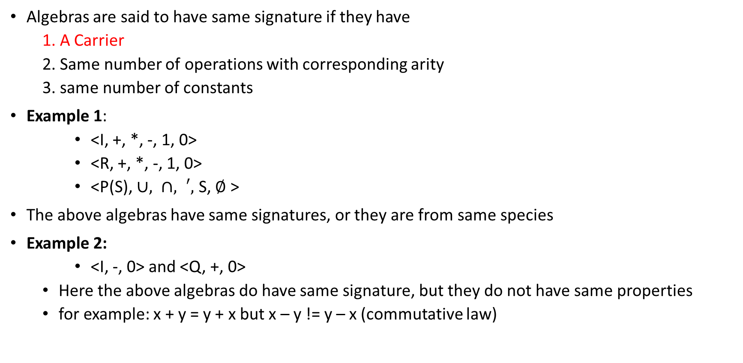
Algebras of same signature or from same species
Algebras are said to have same signature if they have
1. A Carrier
2. Same number of operations with corresponding arity
3. same number of constants
Example 1:
<I, +, *, -, 1, 0>
<R, +, *, -, 1, 0>
<P(S), $∪, ∩, ′,$ S, $∅$>
The above algebras have same signatures, or they are from same species
Example 2:
<I, -, 0> and <Q, +, 0>
Here the above algebras do have same signature, but they do not have same properties
for example: x + y = y + x but x – y != y – x (commutative law)

Slide 7
Axioms
Axioms are rules that algebras follow.
Example: Semi groups will follow a set of axioms, groups will follow a set of operations

Slide 8
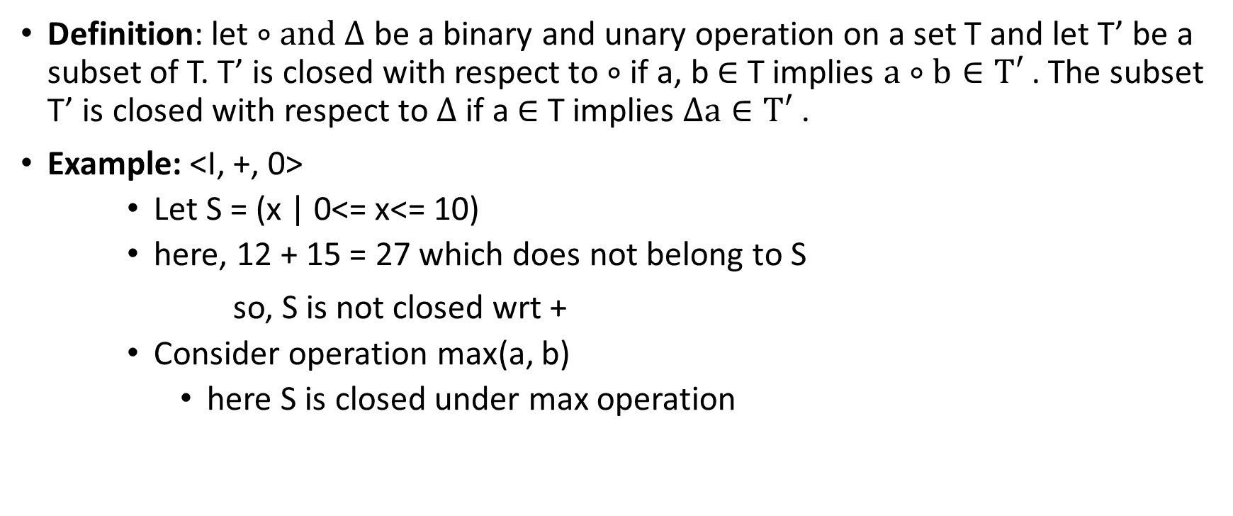
Closure Property
Definition: let $∘and ∆$ be a binary and unary operation on a set T and let T’ be a subset of T. T’ is closed with respect to $∘$ if a, b $∈$ T implies $a∘b∈T′$. The subset T’ is closed with respect to $∆$ if a $∈$ T implies $∆a∈T′$.
Example: <I, +, 0>
Let S = (x | 0<= x<= 10)
here, 12 + 15 = 27 which does not belong to S
so, S is not closed wrt +
Consider operation max(a, b)
here S is closed under max operation

Slide 9
Contd…
Example 2: Let If A = {0, 1},
We have
0 × 0 = 0,
0 × 1 = 0,
1 × 0 = 0, and
1 × 1 = 1
so A is closed under multiplication.
But A is not closed under the binary operation addition. Since 1 + 1 = 2 does not belong to A.

Slide 10
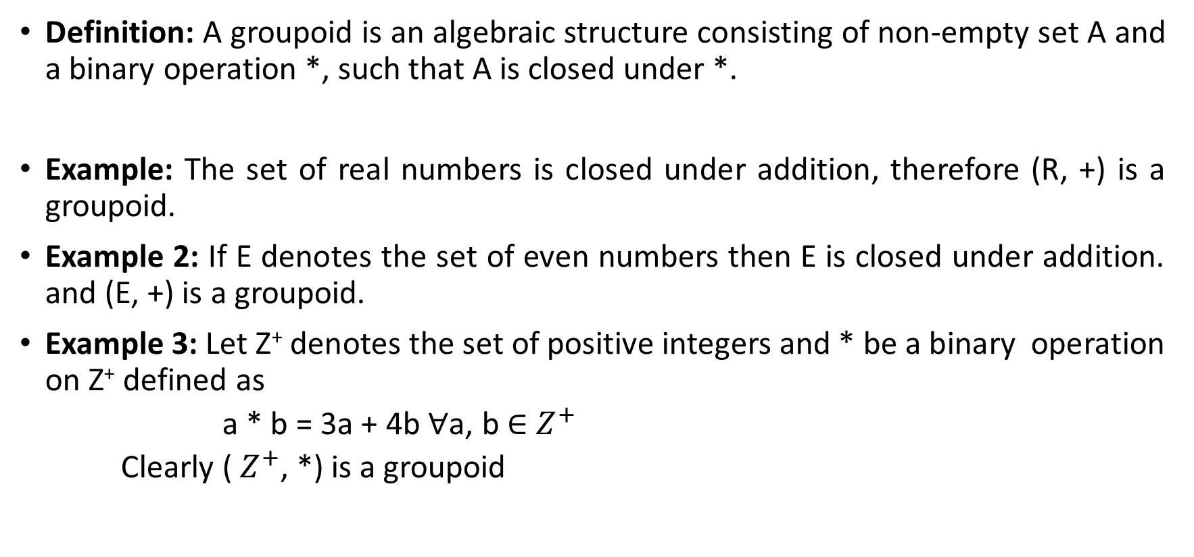
Groupoid
Definition: A groupoid is an algebraic structure consisting of non-empty set A and a binary operation *, such that A is closed under *.
Example: The set of real numbers is closed under addition, therefore (R, +) is a groupoid.
Example 2: If E denotes the set of even numbers then E is closed under addition. and (E, +) is a groupoid.
Example 3: Let Z⁺ denotes the set of positive integers and * be a binary operation on Z⁺ defined as
a * b = 3a + 4b ∀a, b ∈ $Z^{+}$
Clearly ( $Z^{+}$, *) is a groupoid

Slide 11
Semi-Group
Definition: Let S be a non-empty set and * be a binary operation on S. The algebra (S,*) is called a semi-group if the operation * is associative.
In other words, the groupoid is a semi-group
if (a * b) * c = a * (b * c) for all a, b, c ∈ S
Thus, a semi-group requires the following:
(i) A set S.
(ii) A binary operation * defined on the elements of S.
(iii) Closure, a * b whenever a, b ∈ S
(iv) Associativity (a * b) * c = a * (b * c) for all a, b, c ∈ S
Example 1: Let N be the set of natural numbers. Then (N, +) and (N, *) are semi-groups.

Slide 12
Contd…
Example 2: X be a non-empty set and P (X) denote the power set of X. Then (P(x), ∪) and (P (x ), ∩ ) are semi-groups.
Example 3: Let Z be the set of integers and Z_{m} be the set equivalence classes generated by the equivalence relation “congruent modulo M” for any positive integers m. Then +_{m} be defined integers of + on Z as follows:
For any [i], [ j] ∈ Z_{m}
[i] +_{m} [ j] = [(i + j) mod m]
The algebraic system (Z_{m}, + m) is a semi-group

Slide 13
Homomorphism of Semi-Groups
Definition: Let (S, *) and (T, o) be any two semi-groups. A mapping f: S → T such that for any two elements a, b ∈ S
f (a * b) = f (a) o f (b)
is called a semi-group homomorphism.
Definition: A homomorphism of a semi-group into itself is called a semi-group endomorphism.

Slide 14
Isomorphism of Semi-Group
Definition: Let (S, *) and (T, 0) be any two semi-groups. A homomorphism f: S → T is called a semi-group isomorphism if f is one-to-one and onto.
If f: S → T is an isomorphism then (S, *) and (T, 0) are said to be isomorphic.
Definition: An isomorphism of a semi-group onto itself is called a semi-group automorphism.

Slide 15
Monoid
Definition: A semi-group (M, *) with an identity element with respect to the binary operation * is called a monoid.
In other words, an algebraic system (M, *) is called a monoid if:
(i) (a * b) * c = a * (b * c) ∀ a, b, c ∈ M
(ii) There exists an element e ∈ M such that
e * a = a * e = a ∀ a ∈ M. (i.e. Identity Element)
Example 1: Let Z be the set of integers (Z, +) is a monoid 0 is the identity element in Z with respect to +.

Slide 16
Contd…
Commutative Monoid: Let (M, *) be a monoid. If the operation * is commutative then (M, *) is said to be commutative monoid.
If a^{i} a^{j} ∈ M we have a^{i+j} = a^{i} * a^{j} = a^{j} * a^{i} for all i, j ∈ M.
Cyclic Monoid: A monoid (M, *) is said to be cyclic if there exists an element a ∈ M. Such that every element of M can be expressed as some power of a.
If M is a cyclic monoid such that every element is some power of a ∈ M, then a is called the generator of M.
A cyclic monoid is commutative and may have more than one generator.

Slide 17
Monoid Homomorphism
Definition: Let (M, *) and (T, 0) be any two monoids e_{m} and e_{t} denote the identity elements of (M, *) and (T, 0) respectively. A mapping
f: M → T
such that for any two elements a , b ∈ M
f (a * b) = f (a) o f (b)
and f (e_{m}) = e_{t}
is called a monoid homomorphism.
Monoid homomorphism presents the associativity and identity.
It also preserves commutative.
If a ∈ M is invertible and a⁻¹ ∈ M is the inverse of a in M, then f (a^{–1}) is the inverse of f (a), i.e., f (a^{–1}) = [f (a)]^{–1}.

Slide 18
Groups
Definition: A group is an algebraic structure (G, *) in which the binary operation * on G satisfies the following conditions:
G – 1 for all a, b, c, ∈ G
a * (b * c) = (a * b) * c (associativity)
G – 2 there exists an elements e G ∈ such that for any a G ∈
a * e= e * a = a (existence of identity)
G –3 for every a ∈ G, there exists an element denoted by a^{–1} in G
such that
a * a^{–1} = a^{–1} * a = e
a^{–1} is called the inverse of a in G

Slide 19
Contd…
Example 1: (Z, +) is a group
where Z denote the set of integers.
Example 2: (R, +) is a group
where R denote the set of real numbers.

Slide 20
Abelian Group
Definition: Let (G, *) be a group. If * is commutative that is
a * b = b * a for all a, b ∈ G
then (G, *) is called an Abelian group.
Example: (Z, +) is an Abelian group

Slide 21
Finite and Infinite Group
Finite Group
Definition: A group G is said to be a finite group if the set G is a finite set.
Example: G = {–1, 1} is a group with respect to the operation multiplication. Where G is a finite set having 2 elements. Therefore, G is a finite group.
Infinite Group
A group G, which is not finite is called an infinite group.

Slide 22
Order of a Finite Group
Definition: The order of a finite group (G, *) is the number of distinct elements in G.
The order of G is denoted by O(G) or by |G|.
Example: Let G = {–1, 1}
The set G is a group with respect to the binary operation multiplication and O(G) = 2.

Slide 23
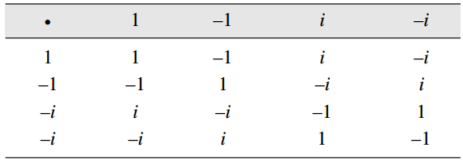

Example 1
Show that the set G = {1, –1, i, –i} where i = $\sqrt{−1}$ is an abelian group with respect to multiplication as a binary operation.
Solution: Let us construct the composition table
From the table we can say (G, ⋅) is closed under the ⋅ operation

Slide 24
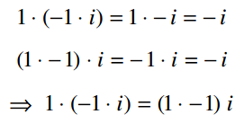
Contd…
We have to check whether the above algebraic structure (G, ⋅) satisfies the following axioms
Associativity
Existence of Identity
1 is identity element of (G, ⋅) such that 1⋅a = a = a⋅1 ∀ a ∈ G

Slide 25
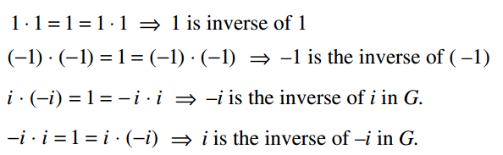
Contd…
Existence of inverse
Thus all the axioms of a group are satisfied.

Slide 26
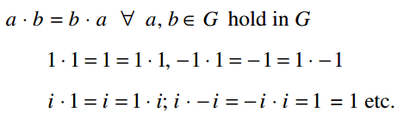
Contd…
Commutativity
commutative law is satisfied
Hence (G, ⋅) is an abelian group

Slide 27
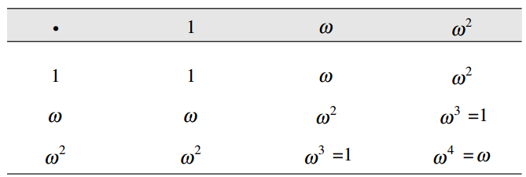
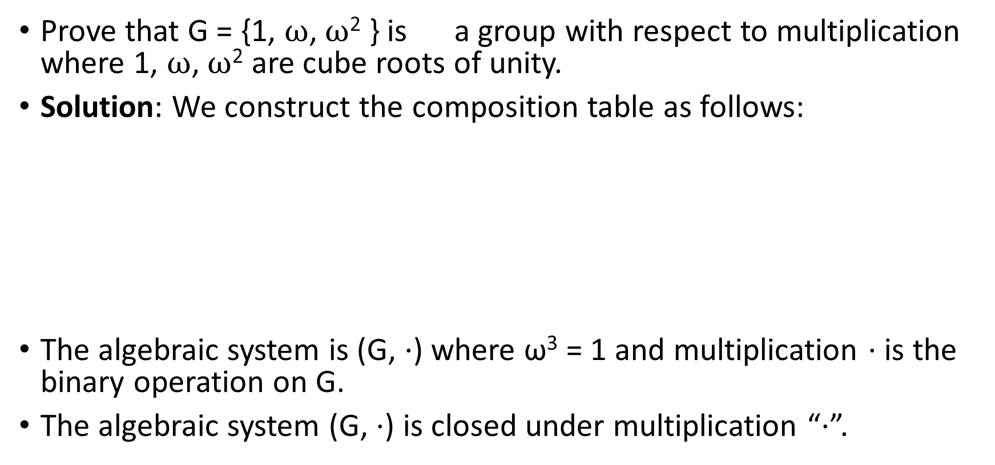
Example 2
Prove that G = {1, $ω$, $ω$² } is a group with respect to multiplication where 1, $ω$, $ω$² are cube roots of unity.
Solution: We construct the composition table as follows:
The algebraic system is (G, ⋅) where ω³ = 1 and multiplication ⋅ is the binary operation on G.
The algebraic system (G, ⋅) is closed under multiplication “⋅”.

Slide 28
Contd…
Let us check axioms of groups
Associativity
from the table we can say ⋅ is associative
Existence of Identity
1 is identity element of (G, ⋅) such that
1⋅a = a = a⋅1 ∀ a ∈ G
Existence of inverse
Each element of G is invertible
1 ⋅ 1 = 1 ⇒ 1 is its own inverse.
ω ⋅ ω² = ω³ = 1 ⇒ ω² is the inverse of ω and ω is the inverse of ω² in G
Thus all the axioms of a group are satisfied.
Commutativity
commutative law hold wrt multiplication
Hence (G, ⋅) is an abelian group

Slide 29
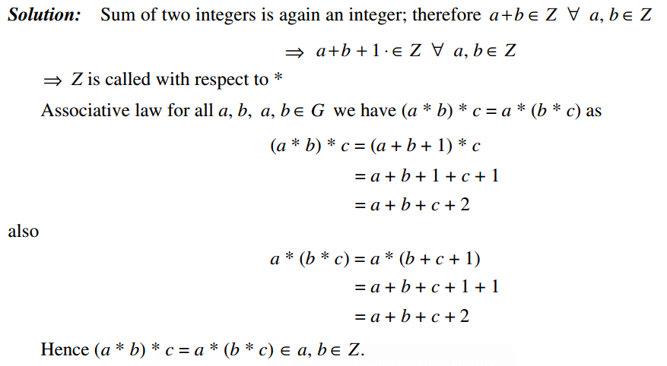
Example 3
Example 3: Prove that the set Z of all integers with binary operation * defined by a * b = a + b + 1 ∀ ∈ a b G , is an abelian group.
Solution

Slide 30
Sub-Group
Definition: Let (G, *) be a group and H, be a non-empty subset of G. If (H, *) is itself is a group, then (H, *) is called sub-group of (G, *).
Example 1: Let a = {1, –1, i, –i} and H = {1, –1} G and H are groups with respect to the binary operation, multiplication.
H is a subset of G, therefore (H, X) is a sub-group (G, X).
Example 2: Consider (Z₆, +₆), the group of integers modulo 6.
H = {0, 2, 4} is a subset of Z₆ and
{H, +₆} is a group.
∴ {H, +₆} is a sub-group.

Slide 31
Ring
Definition: An algebraic system (R, +, ⋅) is called a ring if the binary operations ‘+’ and ‘ ⋅ ’ R satisfy the following properties:
1. (R, +) is an abelian group.
2. (R, ⋅) is a semi-group.
3. The operation ‘⋅ ’ is distributive over +,
that is for any a, b, c ∈ R,
a ⋅ (b + c) = a ⋅ b + a ⋅ c and
(b + c) ⋅ a = b ⋅ a + c ⋅ a

Slide 32

Example
Example 1: The set of integers Z, with respect to the operations + and × is a ring.
Example 2: The set of all matrices of the form
where, a and b being real numbers,
with matrix addition and matrix multiplication is a ring.

Slide 33
Resource
Discrete mathematics structures – G. Shanakr Rao - 2 Ed

